Slide 1
IBM + Coursera Capstone Project:
Seattle Business Discount Partnerships Around Art
Mark A. Olazabal

Slide 2
Purpose
Small businesses are looking for ways to attract new customers
Public art is woven throughout the city in walkable areas
By combining public art and nearby venues, it can increase visits
Tourists and local businesses can benefit from uniting

Slide 3
Data
Public Art Location data came from the Seattle Open Data Portal
This provided: 313 art titles, descriptions, and latitude/longitude coordinates
Adjacent Venues data came from a Foursquare API call using the Art Location data
This provided us with 2225 adjacent venue titles, location, and Foursquare category

Slide 4
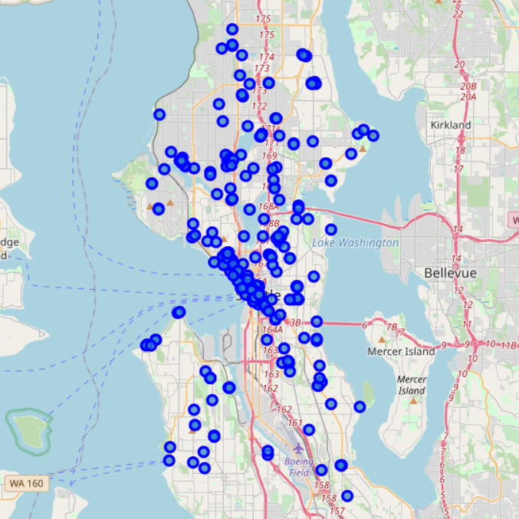
Art Distribution

Slide 5
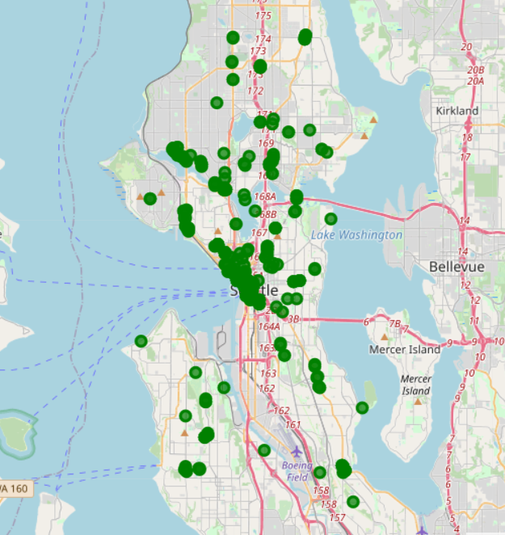
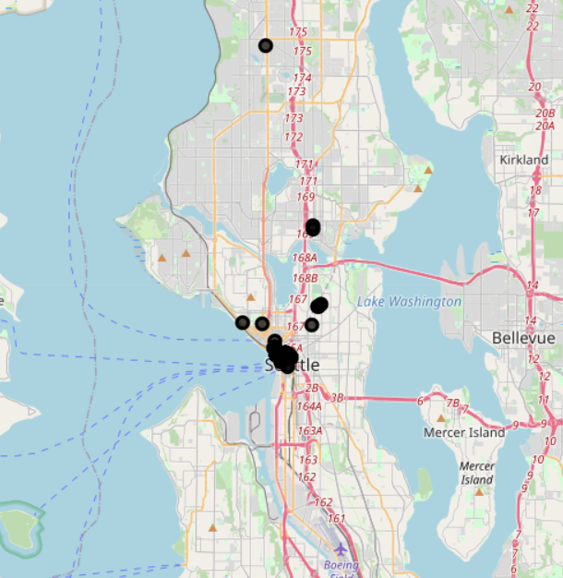
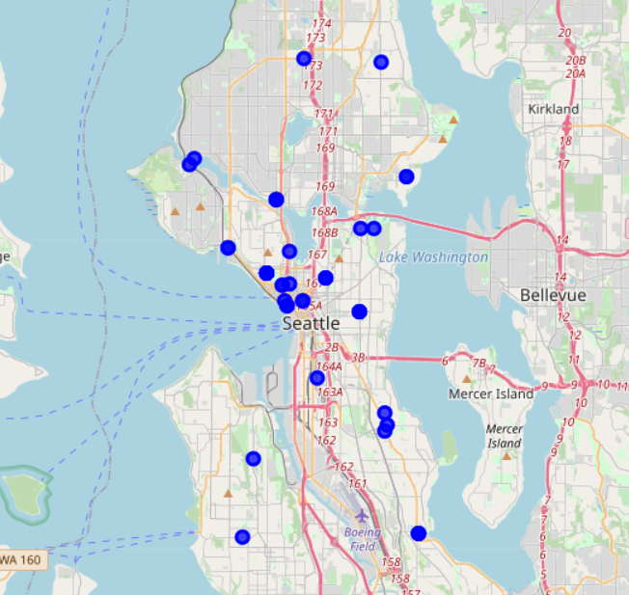
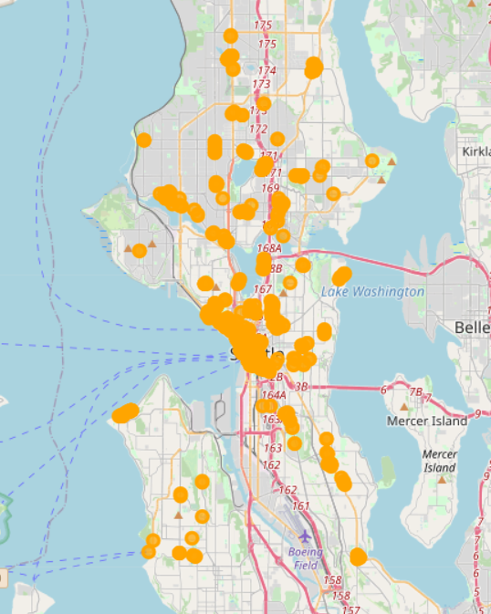
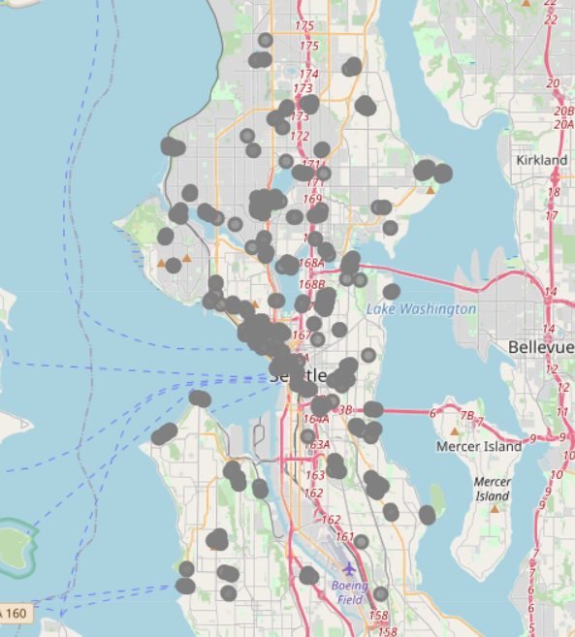
Venue Category Distribution
Service
Retail
Hospitality
Recreation
Food

Slide 6
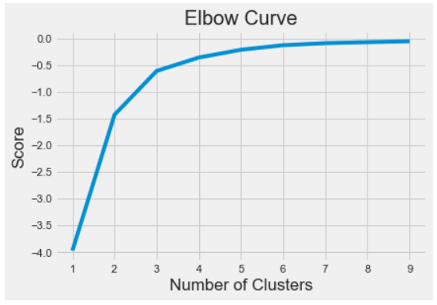
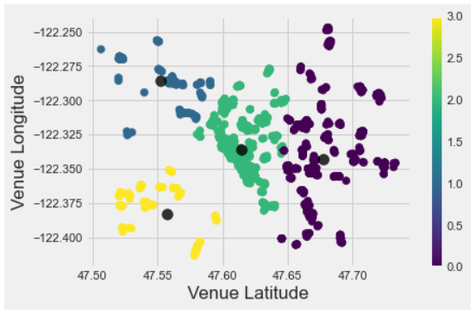
K-Means Clustering
The “Elbow Test” to check potential Ks.
While 3 clusters would have been sufficient, I opted for 4 clusters since this was going to determine the size of the walkable regions for tourists.
The actual clustering.
This divided Seattle into four regions:
North, Central, Southwest, Southeast.

Slide 7
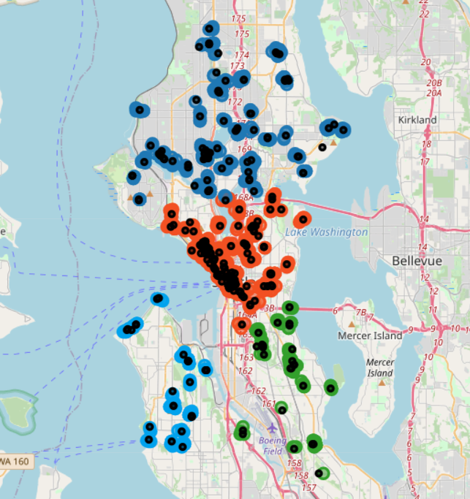
Overall Venue and Art Map
The four regions with art over-laid as black markers.

Slide 8
Tourist Walking Suggestions
Each of the following four region walking maps is a link to the Google Maps source

Slide 9
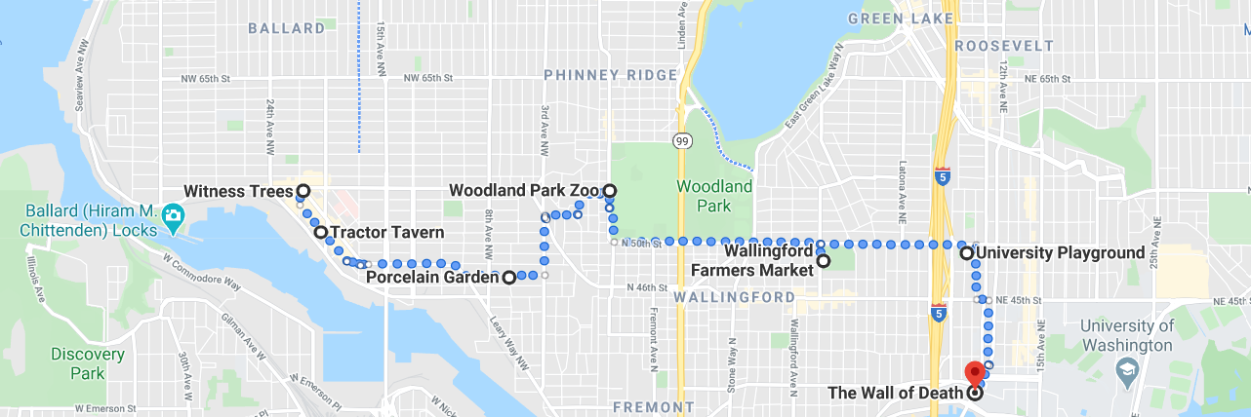
Tourist Walking Suggestion: North Region

Slide 10
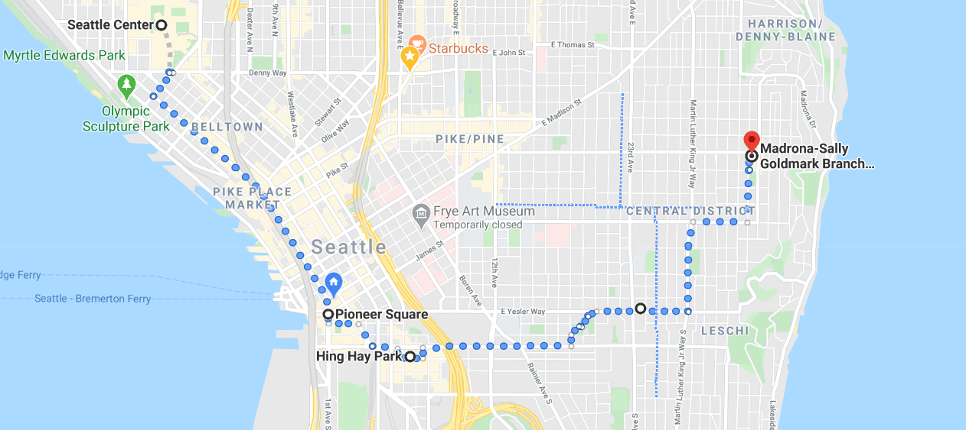
Tourist Walking Suggestion: Central Region

Slide 11
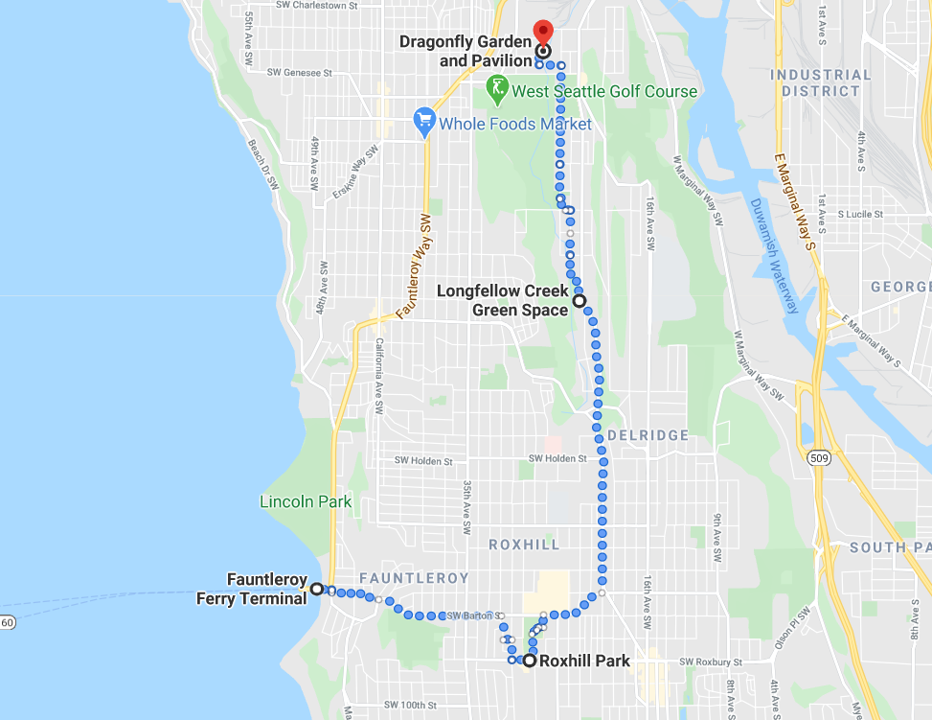
Tourist Walking Suggestion: Southwest Region

Slide 12
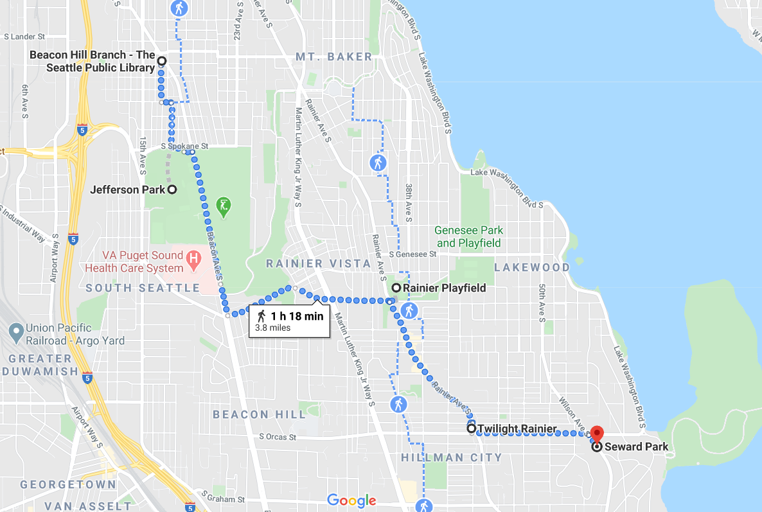
Tourist Walking Suggestion: Southeast Region

Slide 13
Venue Lists for Business Owners
North Region Venues: https://github.com/Mark-Olazabal/IBM-Capstone-Project/blob/master/North_Region.csv
Central Region Venues: https://github.com/Mark-Olazabal/IBM-Capstone-Project/blob/master/Central_Region.csv
Southwest Region Venues: https://github.com/Mark-Olazabal/IBM-Capstone-Project/blob/master/SWest_Region.csv
Southeast Region Venues: https://github.com/Mark-Olazabal/IBM-Capstone-Project/blob/master/SEast_Region.csv

Slide 14
Conclusions
Using the Venue Lists, I would reach out to nearby venues and offer to work out a mutual discount or punch card program
Using the Walking Maps and Art Location maps, as a tourist, I would frequent the businesses participating and walk by the public art pieces
Example on next slide

Slide 15
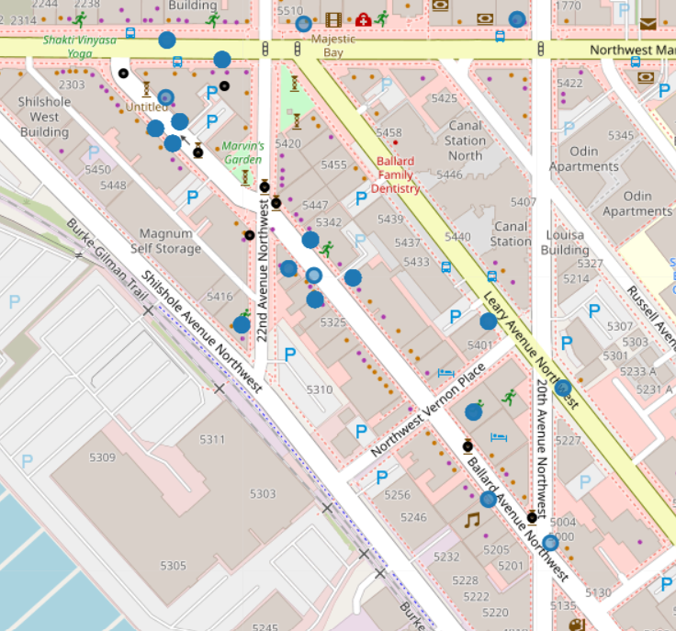
Example: Ballard Ave NW
The following venues along Ballard Ave NW could offer a punch card program for this area:
Dandelion Botanical Company
La Carta De Oaxaca
Hot Cakes Molten Chocolate Cakery
San Fermo
Ballard Farmers Market
Lucca Great Finds
Tractor Tavern
This line of businesses would invite tourists to walk along the following public art pieces:
Untitled (1)
Untitled (2)
Vagor 1 and Vagor 2
Coelacanths
Ballard Centennial Bell Tower
Untitled (3)
Catfish

